Slide 1
Automotive human detection and temperature controlled fan
by,
k. Janarthanan,
A. Essakisuriya,
ECE 3rd year
SCAD COLLEGE OF ENGINEERING AND TECHNOLOGY.

Slide 2
Abstract
An automatic human detection and temperature controlled household electric celling fan is designed and developed by using a PIR sensor and TEMPERATURE sensor(LM35). Pir sensor and temperature sensor switch to automatically detect the human motion and regulate the speed of the fan, to create the breeze to enhance convective heat transfer. This fan automatically changes the speed in five different level with respect to the temperature.

Slide 3
content
Introduction
Components
Circuit diagram
Working function
Testing
Testing results
Pro and corns
Conclusion

Slide 4
introduction
Automatic human detected and temperature controlled household electric celling fan is designed and developed by using the PIR sensor and TEMPERATURE sensor.
This PIR sensor using to detected a motion/mobility on surrounding surface for human detection And the temperature sensor using to detected the current temperature on surrounding place for regulating the speed of the electronic celling fan.

Slide 5
components
1.PIR sensor:
pir sensor defines passive infrared sensor. It is the one of the type of the motion dections by using the concept of the heat energy transmission at surrounding.
Funtion:
pir sensor can detect animal/human movement in a requirement range. PIR is made of a pyroelectric sensor, which is able to detect different levels of infrared radiation. The detector itself does not emit any energy but passively receives it.
It detects infrared radiation from the environment. Once there is infrared radiation from the human body particle with temperature, focusing on the optical system causes the pyroelectric device to generate a sudden electrical signal.

Slide 6
2.Thermistor:
The Thermistor or simply Thermally Sensitive Resistor is a thermistor that works on the principle of varying resistance with temperature. They are made of semiconducting materials.
Working Principle of Thermistors
The thermistor works on the simple principle of change in resistance due to a change in temperature. When the ambient temperature changes the thermistor starts self-heating its elements. its resistance value is changed with respect to this change in temperature. This change depends on the type of thermistor used.
3.LCD 16×2:
The term LCD stands for liquid crystal display. It is one kind of electronic display module used in an extensive range of applications

Slide 7
arduino
Arduino is an open-source electronics platform based on easy-to-use hardware and software.
Arduino boards are able to read inputs - light on a sensor, a finger on a button, or a Twitter message - and turn it into an output - activating a motor, turning on an LED, publishing something online.
You can tell your board what to do by sending a set of instructions to the microcontroller on the board.
To do so you use the Arduino programming language (based on Wiring), and the Arduino Software (IDE), based on Processing.

Slide 8
Block diagram:
PIRSENSOR
ARDUINO
LCD DISPLAY
THERMISTOR
DC MOTOR

Slide 9
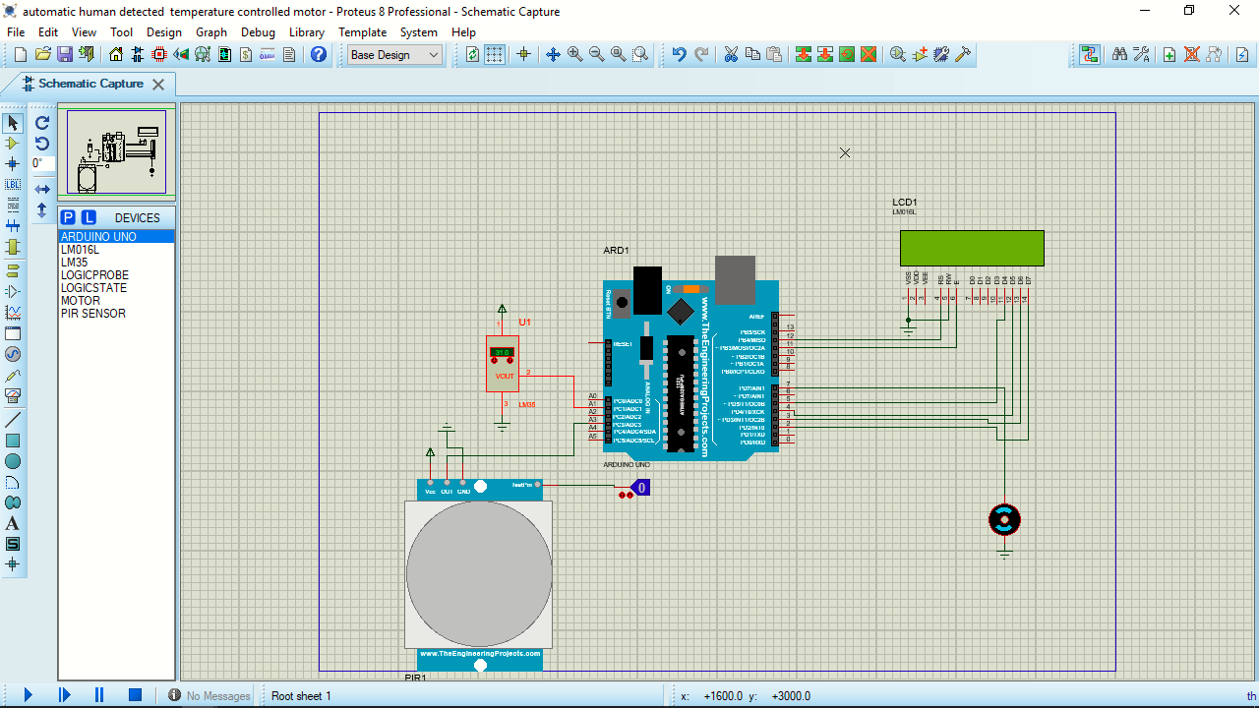
Circuit diagram

Slide 10
working
PIR sensor and thermistor are giving the data to Arduino controller through the analog pin. Arduino controller uses these data then the process initiated inside the controller’s chip by using the Arduino program idle.
In this process, Pir sensor higher priority than thermistor.
After the processing the data , the output will get in the digital pin of Arduino.
The output devices like a lcd display , motor, led lights and etc are collect the data through the digital pin and show the output.

Slide 11
testing
Testing condition | Expecting result
No motion in the surrounding place | Fan will be off
Motion in the surrounding place | fan will be on
Testing condition | Expecting result
After human detection, temperature in between 20°C to 23°C | Fan speed is 20%
Temperature between 24°C to 25°C | Fan speed is 40%
Temperature between 26°C to 28°C | Fan speed is 60%
Temperature between 29°C to 30°C | Fan speed is 80%
Temperature above 30°°C | Fan speed is 100%

Slide 12
FLOW CHART:
start
READ pirsensor, temp
Pirsensor==high
Motor is on
Fan speed 0%
Temp<C1
Fan speed 20%
C1<Temp<C2
Motor is off
Fan speed 40%
C2<Temp<C3
Fan speed 60%
C3<Temp<C4
Fan speed 80%
C4<Temp<C5
Temp>C5
Fan speed 100%
end

Slide 13
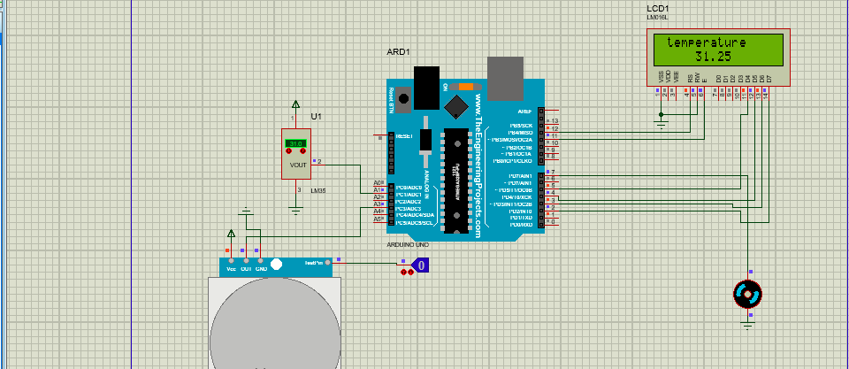
Testing result:
condition 1: When the move able object not presented in mentionable distance(coverage area) , then the motor should be off.

Slide 14
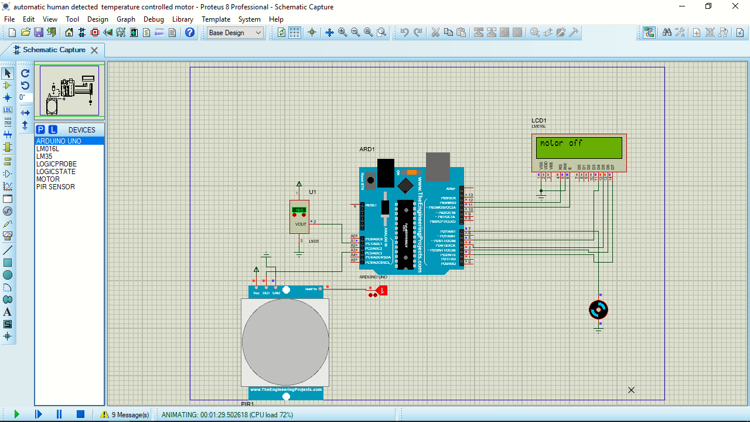
Condition 2:
1.A moveable object presented in some mentionable distance. So ,the motor should be run.
2. Then the surrounding temperature is decide the level of voltage. The temperature is below the cut-off(20) value the motor should be off .

Slide 15

Condition 3:
Now the temperature is above the cut off (20C)value so motor is running but below the cutoff1 (23C) value
voltage regulated 1:5. speed is 20 percent

Slide 16

Condition 4:
the temperature value in between cut off 1(23C) and cut-off 2 (25C)
the voltage was regulated 2:5.

Slide 17

Condition 5:
the temperature value is between cut-off 2(25C) and cut-off 3(28C)
the voltage was regulated 3:5. motor speed is 60 percent.

Slide 18

Condition 6:
the temperature value is between cut off 3 and cut-off 4 the voltage was regulated 4:5. the motor speed is 80 percentage

Slide 19
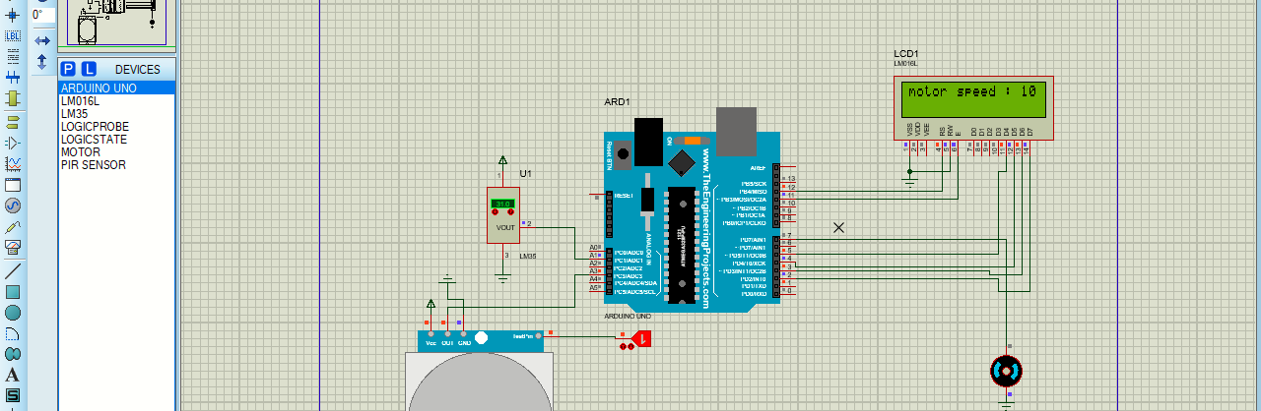
Condition 7:
the temperature value is between cut off 4 and cut off 5 the voltage was regulated 5:5. the motor speed 100%

Slide 20
Pro and corns
Pro:
not need to switching
Power consumption
Eco-logical
weather monitoring
Corns:
over usage make the damage on controller ic.

Slide 21
Thank
you
all

